Slide 1
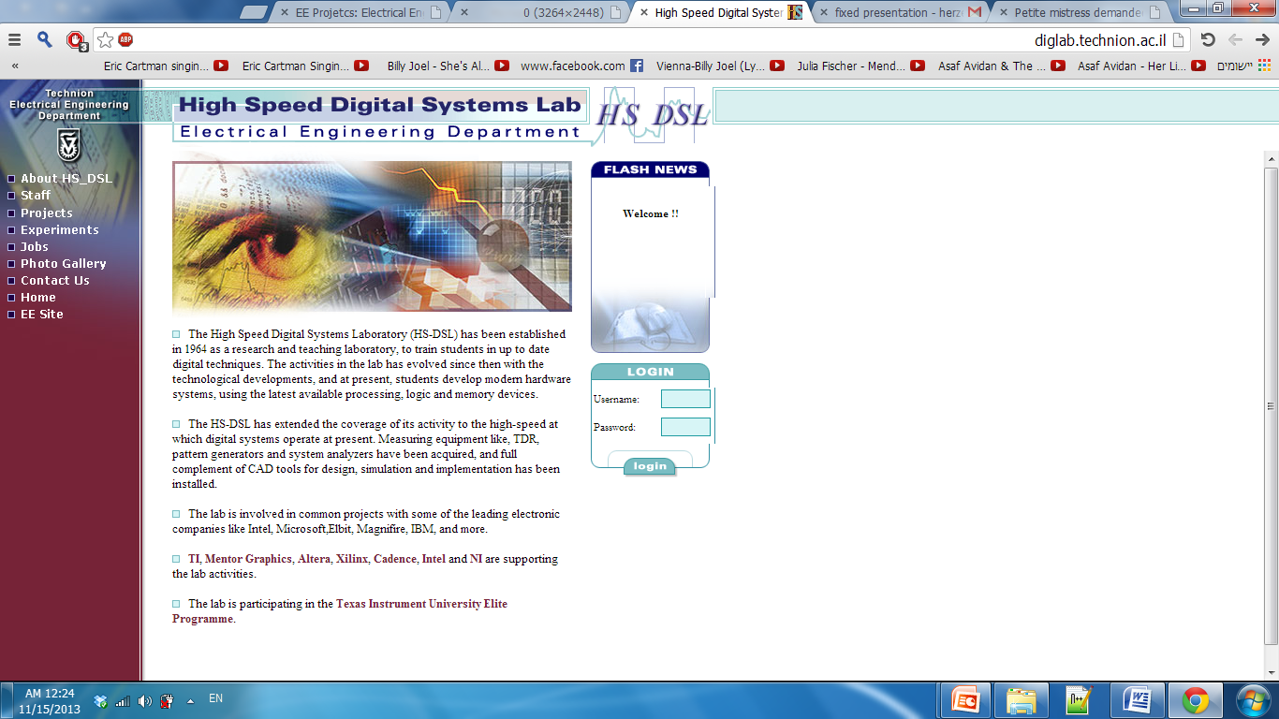

Characterization Presentation Subject : Hardware DLL 2-Semester Project
Submitted by : Anton Vainer , Alon Reznik
Supervisors : Ina Rivkin , Oz Shmueli

Slide 2
Motivation
SW execution can be slow. Most parallel algorithms can be executed faster by dedicated HW accelerators on an FPGA.
An OS can contain many SW processes, but
An FPGA can NOT contain as many HW accelerators.
Executing suitable algorithms by HW accelerators will free the CPU for other tasks.

Slide 3
Project Goal
Design and implement an innovative embedded system architecture which provides capabilities to change the hardware in Real Time according to the application needs.
Transparent to the user – the system user is unaware of the architectural modification.
Application development – easy implementation of HW accelerators and software using native programming languages (C/C++) and standard tools.

Slide 4
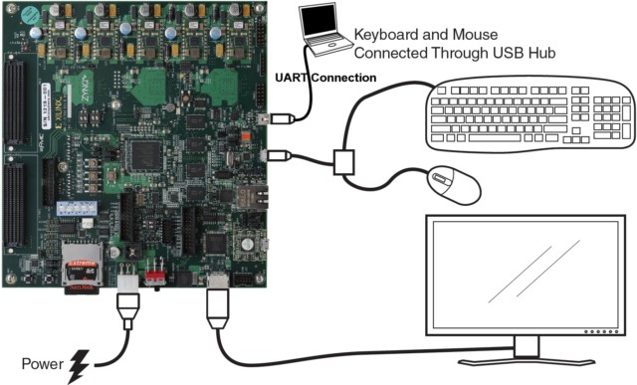
System Overview
Linux OS

Slide 5
Project specifications
Implementation on Xilinx ZYNQ-7000 board with embedded partially reconfigurable FPGA.
Linux OS environment.
All accelerated functions will connect to the host via AXI bus with fixed addresses and sizes.

Slide 6
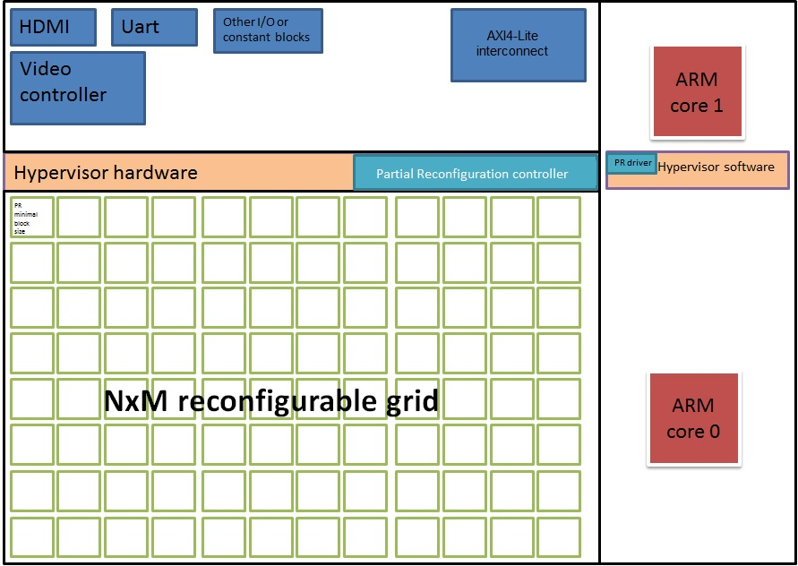
System Block Diagram:

Slide 7
How it works ?
The FPGA will have empty blocks with fixed AXI bus interface.
We will provide a set of guidelines for developers to convert C/C++ functions to FPGA HW and use them during runtime.
The integrated software will track available blocks on the FPGA and assign them on run time dynamically.

Slide 8
Final Usage model
Select a C/C++ function suitable for HW acceleration
Using Xilinx HLS SW create FPGA design that meets HW DLL constraints
Define AXI interface for the created design
Generate partial bitstreams from the design for a PR Block
Use the provided API to load the bitstream on to the FPGA
Use the provided pointer to run the design
The integrated software will load the bitstream in an empty FPGA slot and provide a pointer.
The pointed function will wrap the HW accelerator interface.

Slide 9
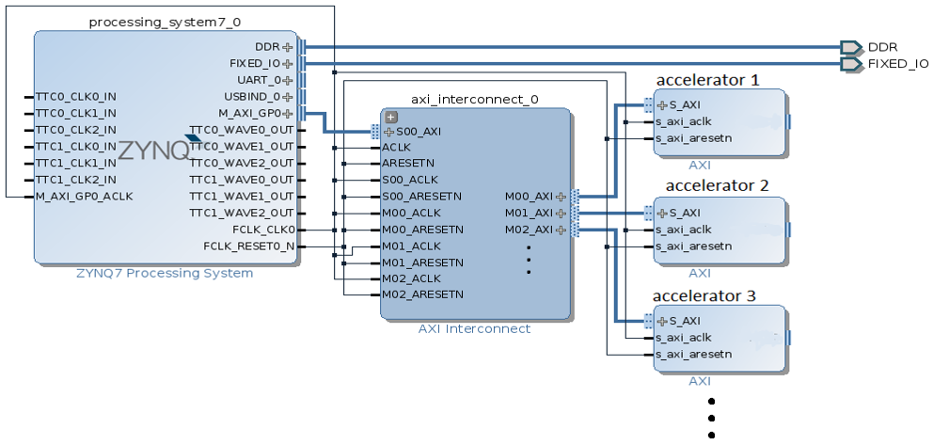
System Logic description
The system with configured blocks will look like this:

Slide 10
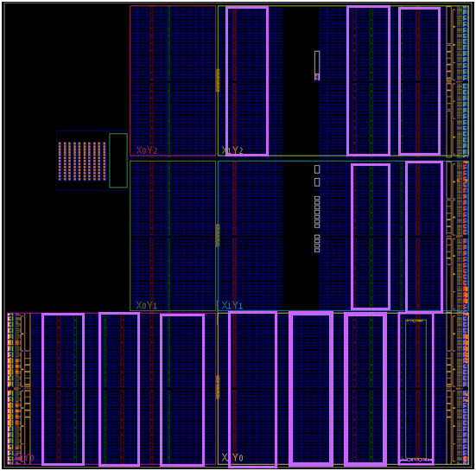
System description
FPGA system, with reconfigurable p_blocks:
Example Accelerators 1-3

Slide 11
Initial HW System API
Status = place_pr_block(pr_p , pr_index);
List = get_free_slots();
Status = remove_pr_block(pr_index);
Status = start_pr_block(pr_index , input_data);
Out_data = pole_pr_block(pr_index);
Status = is_busy(pr_index);

Slide 12
Our Progress So Far
We learned Xilinx tools, including Vivado IDE/HLS/SDK.
We learned full Static and partial reconfiguration of the FPGA using Vivado tools.
We wrote partially configurable modules and loaded them on to FPGA.
We wrote standalone software that uses partially reconfigured modules.
We have booted linux from an SD card on ZC702 board.

Slide 13
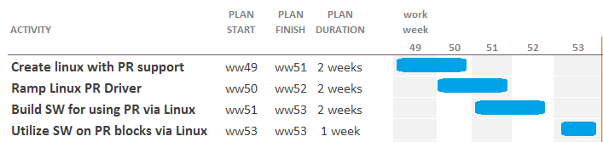
Gantt Chart

